Slide 1
MOODLE SUPPORT IN DigitiZING THE ACADEMIC PROCESS
PhD. Marinel IORDAN, PhD. Gabriel BÎZOI, Ing. Cosmin HERMAN
Affiliazione West University of Timisoara, Email marinel.iordan@e-uvt.ro
gabi.bizoi@e-uvt.ro
cosmin.herman@elearningsoftware.ro

Slide 2
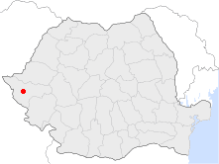
Brief presentation about West University of Timisoara
Timisoara the capital of Banat Region, is the biggest city center and the economic hub of the West Region of Romania
With more than 350.000 inhabitants and over 30.000 students from more than 50 countries, the city represent a heart of culture and learning, modern and cosmopolitan city, future European Capital of Culture in 2023.
West University of Timisoara, is the fourth largest university in Romania and the most academic center in this part of country. The University, was established by Royal Decree in December 1944, 77 years ago.
Marinel IORDAN, Gabriel BÎZOI, Alexandra BÎZOI, Cosmin HERMAN

Slide 3
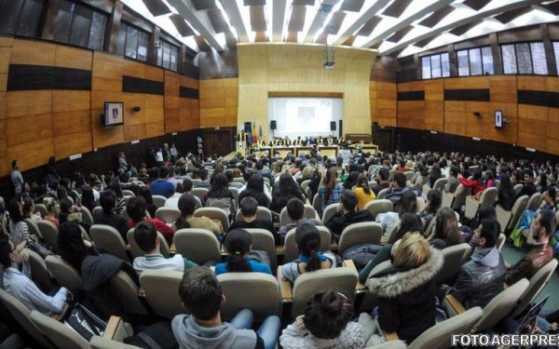
Brief presentation about West University of Timisoara
West University of Timisoara, through the 11 faculties:
Faculty of Arts and Design Faculty of Chemistry, Biology and Geography Faculty of Law Faculty of de Economics Sciences and Bussiness Administration Faculty of Sports Faculty de Political Sciences, Filosophy and Communications Faculty of Physics Faculty of Literature, History and Theology Faculty of Mathematics and Informatics Faculty of Music and Theatre Faculty of de Sociology and Psychology,
upholds the principles of freedom and free of intelectual and artistic expresión. For more than 16.000 students, WUT offer 84 bachelor , 149 master and 37 doctoral programmes and more than 460 partnerships with EU and non-EU universities. Bachelor and master study programmes, are in romanian, and foreign langauages: german, french and english.
Marinel IORDAN, Gabriel BÎZOI, Alexandra BÎZOI, Cosmin HERMAN

Slide 4
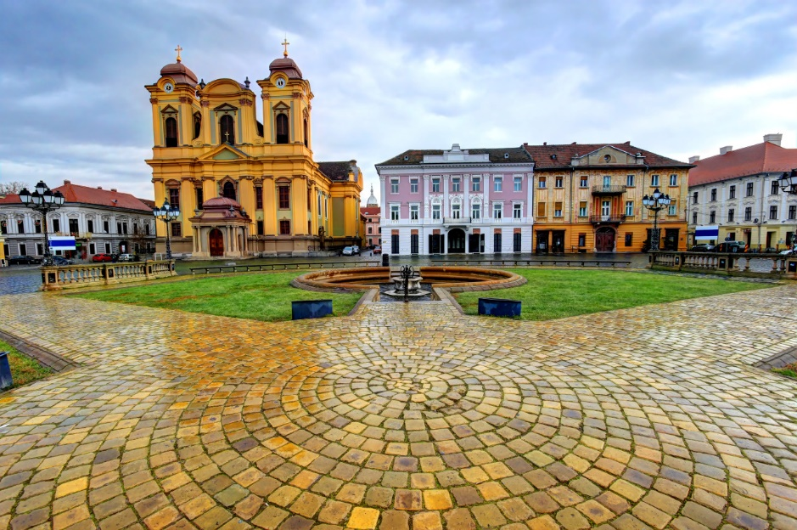
In the latest International Rankings, West University ranks in the top five most important Romanian Universities. Scientific research is fundamental for a high-quality education to conducting innovative projects.
West University of Timisoara, offers 4500 accommodation places in 10 blocks with modern facilities and up-to late infrastructure.
An important step towards is a stronger internationalization at WUT is represented by the UNITA European alliance witch the university is part of, alongside five partners: Universita degli studi di Torino (IT), Universite de Pau et de pays de l’Adour(FR), Universite Savoie Mont-Blanc(FR), Universidad de Zaragoza(ES) and Universidade de Beira Interior(PT).
Marinel IORDAN, Gabriel BÎZOI, Alexandra BÎZOI, Cosmin HERMAN
Marinel IORDAN, Gabriel BÎZOI, Cosmin HERMAN

Slide 5
Paper content
Using Moodle in the Teaching Process
Bachelor and Master Study Programs
Transfer of Good Practices by Postgraduate Programs
Management Reports for the Teaching Process
E-learning UVT - Customized Moodle App
Integrating Moodle with the University Management System
The Need for Integration
Authentication using SAML (Single-Sign-On)
Efficiently design and deliver the Academic Process
Bachelor and Dissertation Papers' Management
Bachelor and Dissertation Exams
Teachers' Evaluation by Students
Marinel IORDAN, Gabriel BÎZOI, Alexandra BÎZOI, Cosmin HERMAN

Slide 6
Topics of interest presented
Plugin developed based on university needs
Questionnaire setup
Questions and type of questions
Questionnaire delivery
Reports and statistics
Teachers’ personal report
Marinel IORDAN, Gabriel BÎZOI, Alexandra BÎZOI, Cosmin HERMAN

Slide 7
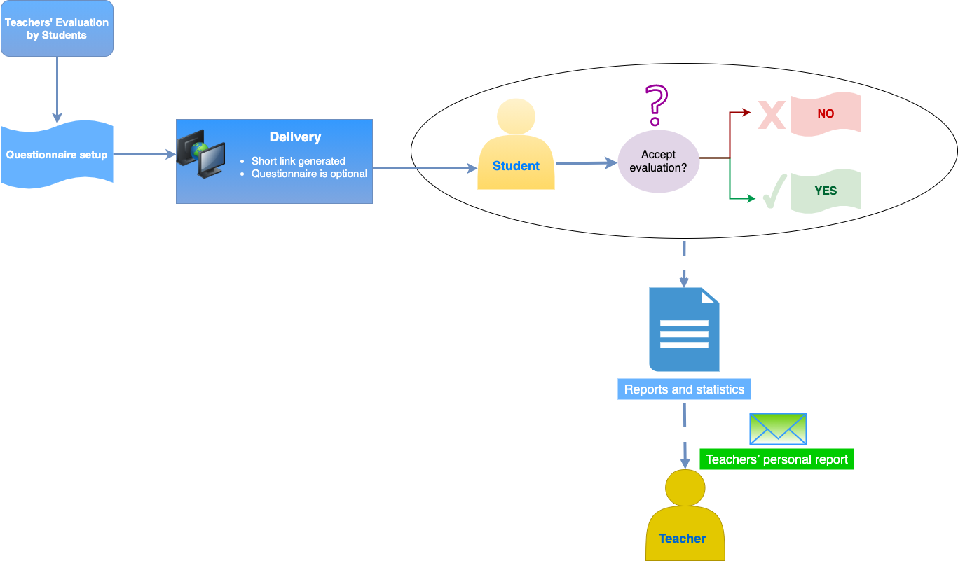
1. Plugin developed based on university needs
Custom plugin
Structure
Algorithm
Marinel IORDAN, Gabriel BÎZOI, Alexandra BÎZOI, Cosmin HERMAN

Slide 8
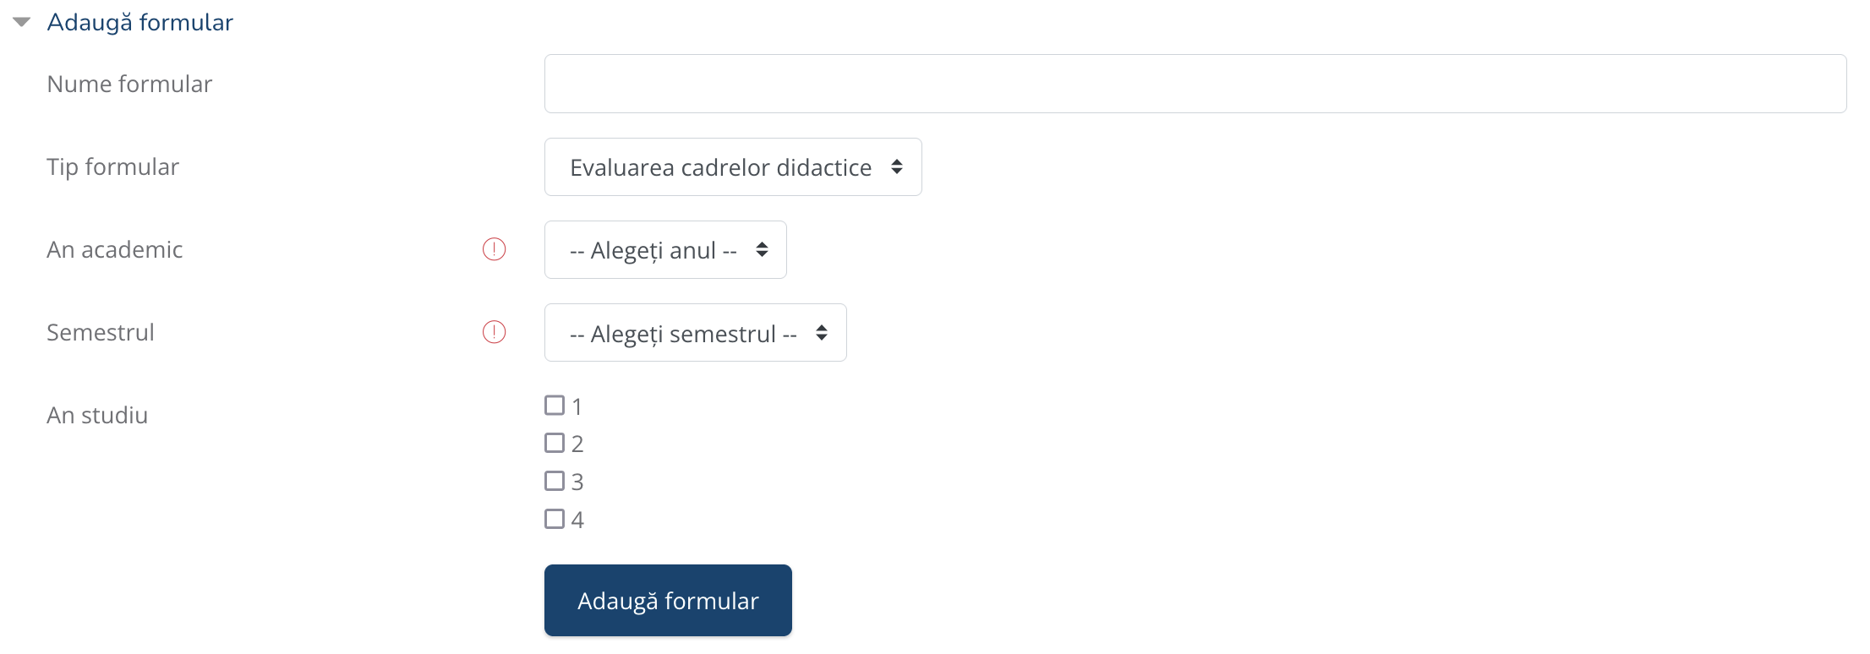
2. Questionnaire setup
Questionnaire list (Create/Read/Update/Delete/Duplicate)
Create new questionnaire form
Name, Type, Academic year, Semester, Year of study
Marinel IORDAN, Gabriel BÎZOI, Alexandra BÎZOI, Cosmin HERMAN

Slide 9
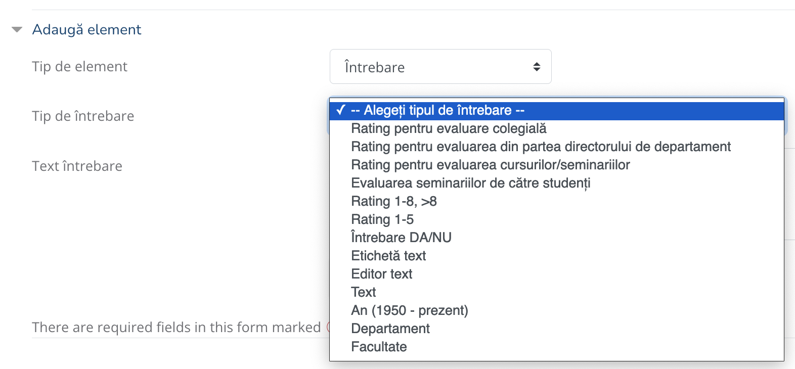
3. Questions and type of questions
Structure
Chapter – Predefined chapter – Section – Question – Type of question
Adding questions
Marinel IORDAN, Gabriel BÎZOI, Alexandra BÎZOI, Cosmin HERMAN

Slide 10
4. Questionnaire delivery
Short link generated – easy student acces
Questionnaire is optional
Marinel IORDAN, Gabriel BÎZOI, Alexandra BÎZOI, Cosmin HERMAN

Slide 11
4. Delivery
Marinel IORDAN, Gabriel BÎZOI, Alexandra BÎZOI, Cosmin HERMAN

Slide 12
5. Reports and statistics
Marinel IORDAN, Gabriel BÎZOI, Alexandra BÎZOI, Cosmin HERMAN

Slide 13
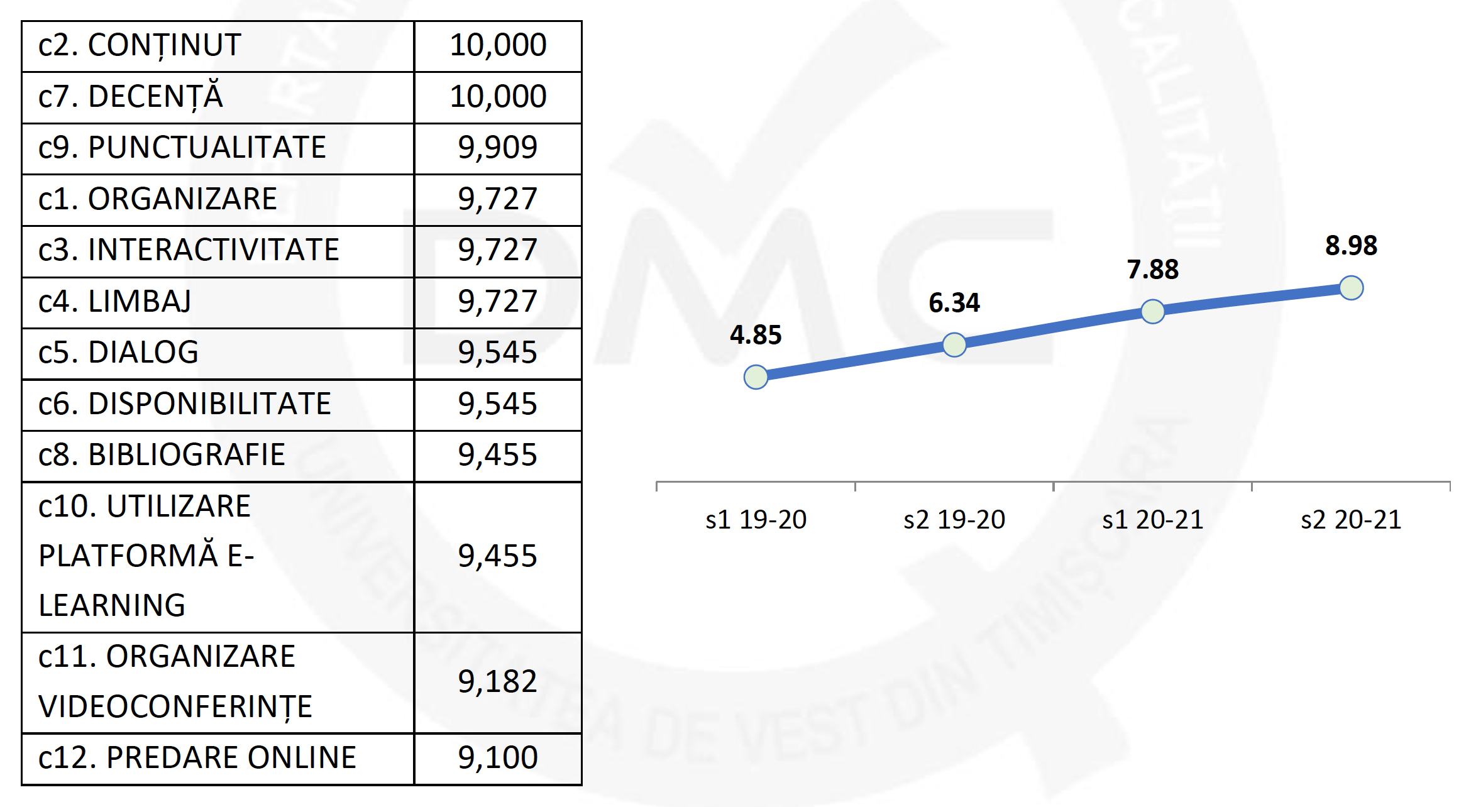
5. Reports and statistics
Marinel IORDAN, Gabriel BÎZOI, Alexandra BÎZOI, Cosmin HERMAN

Slide 14
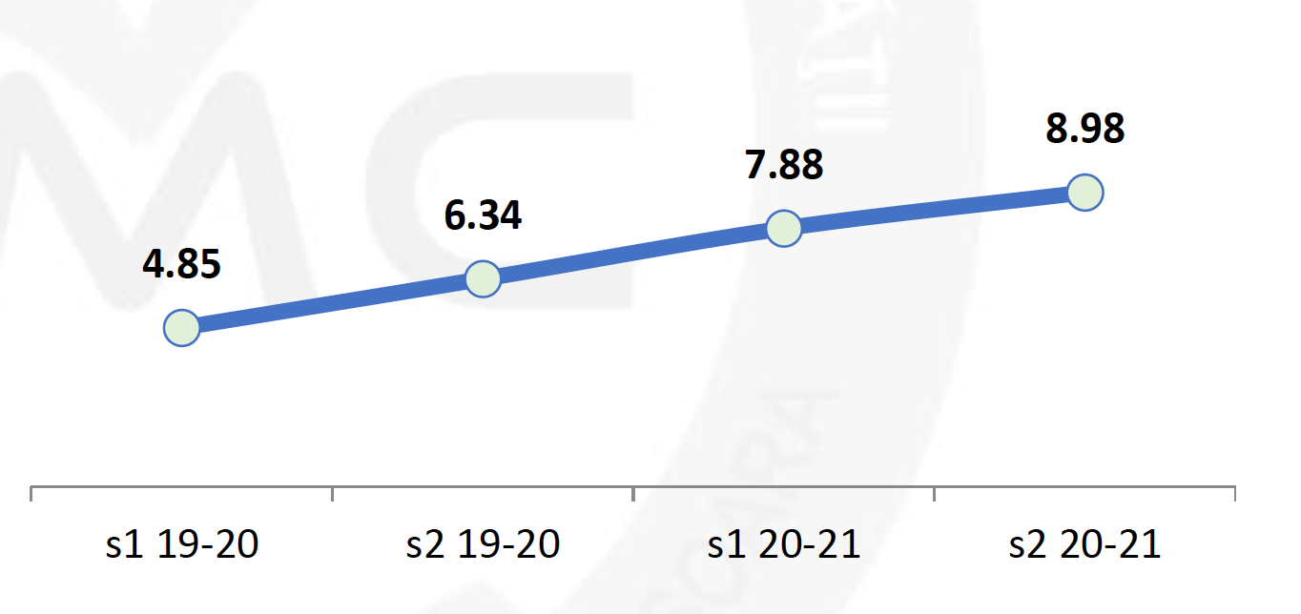
6. Teachers’ personal evolution report
General information
Personal evolution graph
Marinel IORDAN, Gabriel BÎZOI, Alexandra BÎZOI, Cosmin HERMAN

Slide 15
Topics of interest presented
Plugin developed based on university needs
Questionnaire setup
Questions and type of questions
Delivery
Reports and statistics
Teachers’ personal report
Marinel IORDAN, Gabriel BÎZOI, Alexandra BÎZOI, Cosmin HERMAN

Slide 16
Thank you!
Questions?
Marinel IORDAN, Gabriel BÎZOI, Alexandra BÎZOI, Cosmin HERMAN

